Slide 1

Machine Learning
Session One: An Introduction
to Machine Learning
Algorithms &
Approaches
Instructors: Multiple
Hosted by: Brian Lofy, PhD
Source Graphic: tech.com

Slide 2
Course Description
Machine Learning
This introductory course reviews machine learning approaches in use across our industry, commercial companies, and academia. Insight from this course will enable you to make better decisions on ML approaches to fit the problem domain. Whether you are developing your own software solution or leveraging commercial software packages to solve your project’s problem, this course aims to demystify machine learning and describe what is within the ML “Black Box”. This course is a multi-part series which includes ML techniques like:
Regression
Decision Trees
Instance-based and Kernel methods-based Learning
Bayesian Learning
Neural Networks
Deep Learning
During the series we will be joined by guest speakers to describe how they applied machine learning techniques to projects here at BAE systems. After each session you should have an appreciation for the inner workings of ML techniques.
…demystify machine learning and describe what is within the ML “Black Box”…

Slide 3
Course Objectives
Intent of this ML course
Give the student an appreciation for what is “under the hood” of the ML algorithms, if applying COTS or opensource tools, SW packages, etc.
Provide the student a basis to research, develop, and apply a ML algorithm and the intuition into how it will perform on their data set and conditions as they apply to BAE Systems’ projects and examples
You might recognize this first example from Andrew Ng’s ML course (Coursera.org). My aim is to translate this and many more examples so that you can apply it to projects around BAE Systems
Course Book Selection:
Collective Intelligence – Toby Segaran
“comprehensive collection of computational methods for relating vast amounts of data”
“practical, easy-to-understand examples”

Slide 4
Course Dates
October 11: Regression
October 18: Decision Trees
October 25:
Instance-based Learning
Kernel methods-based Learning
2017
Bayesian Learning
Neural Networks
Deep Learning

Slide 5
AI and ML
Artificial Intelligence (AI term was coined by John McCarthy at MIT in 1956)
the capability of a machine to imitate intelligent human behavior (i.e., simulation)
an area of computer science that deals with giving machines the ability to seem like they have human intelligence in learning, reasoning, and self-correction.
Machine Learning
subfield of AI that provides computers with the ability to learn without being explicitly programmed. (1959, Arthur Samuel)
ML is the training of a model from data that generalizes a decision against a performance measure. (Jason Brownlee)
focuses on the development of computer programs that can teach themselves to grow and change when exposed to new data →learn and make predictions on data.
Notes:
You will get insight to Arthur’s statement on ML in our first example, which will dive into an algorithm that does not need explicit programming.

Slide 6
ML
"A computer program is said to learn from experience E
with respect to some class of tasks T
and performance measure P
if its performance at tasks in T,
as measured by P,
improves with experience E.“
(Tom M. Mitchell)
This definition is notable for its defining ML in fundamentally operational rather than cognitive terms.

Slide 7

AI Lineage
MACHINE LEARNING
Pattern Recognition
Information Retrieval
Perceptrons (pred. NN)
ML
RIFT
AI
Statistics
STATISTICS
Generalized Linear Models
Probabilistic Reasoning
RIFT
AI
ARTIFICIAL INTELLIGENCE
Expert Systems
Inductive Logic Programming
ARTIFICIAL INTELLIGENCE
Machine Learning
Statistics
50’s
60’s
70’s
80’s
90’s
00’s
today
Notes:
To understand the evolution of today’s algorithms, let’s take a look at the AI lineage since the late 50’s
AI intended to research cognitive functions such as learning and problem solving.
AI research was established both on statistical theory and from emerging ideas in machine learning, like pattern recognition and computational learning.
- Increasing emphasis on the logical, knowledge-based approaches caused a RIFT between AI purists and the ML camp
- Probabilistic systems were plagued by theoretical and practical problems of data acquisition and representation so the statistics camp fell out of favor with AI purists.
By the 80’s, expert systems dominated AI
Realize that there was and remains a tremendous overlap of algorithmic concepts across the domains, renamed to claim ownership or novelty. For example, ML’s perceptrons/NN is a reinvention of the generalized linear models of statistics.
Despite the RIFT, the ML goals were still focused on solving AI problems during this stage in history. Take for example, OCR was considered as pushing the AI boundaries, but today OCR is commonplace. I remember when much of the AI and ML focus was on fingerprint recognition and face recognition in the 80’s and 90’s, but are also commonplace today.

Slide 8
AI Lineage → ML
Machine learning and data mining often employ the same methods and overlap significantly.
ML
MACHINE LEARNING
Pattern Recognition
Information Retrieval
Perceptrons (aka NN)
MACHINE LEARNING
Pattern Recognition
Information Retrieval
Perceptrons (pred. NN)
ML: Machine learning focuses on prediction, based on known properties learned from the training data.
NN
ML
NEURAL NETWORKS
Backpropagation
Data Mining
Data mining: focuses on the discovery of (previously) unknown properties in the data. This is the analysis step of Knowledge Discovery in Databases (KDD).
DATA MINING
Knowledge Discovery
Statistics
STATISTICS
Generalized Linear Models
Probabilistic Reasoning
AI
ARTIFICIAL INTELLIGENCE
Expert Systems
Inductive Logic Programming
50’s
60’s
70’s
80’s
90’s
00’s
today
Notes:
ML reorganized as a separate field and started to flourish in the 90s.
The ML field changed its goal from achieving artificial intelligence to tackling solvable problems of a practical nature.
It shifted focus away from the symbolic approaches it had inherited from AI, and toward methods and models borrowed from statistics and probability theory.
Neural networks research had been abandoned by AI and computer science around the same time. This line, too, was continued outside the AI/CS field, as "connectionism", by researchers from other disciplines including Hopfield, Rumelhart and Hinton. Their main success came in the mid-1980s with the reinvention of backpropagation.

Slide 9
AI Lineage → ML → today
ML
MACHINE LEARNING
Pattern Recognition
Information Retrieval
Perceptrons (aka NN)
ML
NN
Data Mining
NEURAL NETWORKS
Backpropagation
AI
Data Mining
DATA MINING
Knowledge Discovery
Data Science
Statistics
STATISTICS
Generalized Linear Models
Probabilistic Reasoning
Statistical Learning
AI
ARTIFICIAL INTELLIGENCE
Expert Systems
Inductive Logic Programming
50’s
60’s
70’s
80’s
90’s
00’s
today
Notes:
The overlap in research, algorithms, approaches, and ideas are muddled and fuzzy. It might be easier to visualize the overlap in the next slide.

Slide 10
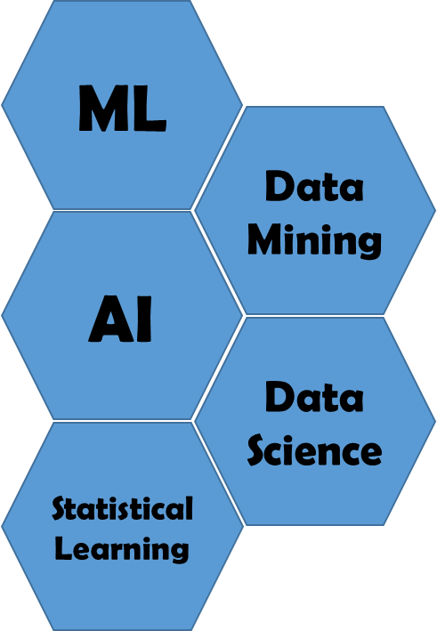
Overlap in today’s fields
PATTERN CLASSIFICATION
ML
STATISTICS
STATISTICAL LEARNING
NEUROCOMPUTING
PATTERN RECOGNITION
Data Mining
AI
Data Science
ML
AI
Statistical Learning
DATA MINING
DATABASES
KDD
LEGEND:
AI – Artificial Intelligence
KDD – Knowledge Discovery in Data Bases
ML – Machine Learning
DATA SCIENCE
Source: adapted from SAS313-2014 graphic dated 1998
Notes:
The literature search also revealed that no one can agree on the overlap or boundaries across the domains, so this is one opinion on the overlapping names of fields given to groups studying algorithms to solve today’s challenges.
https://en.wikipedia.org/wiki/Pattern_recognition - pattern recognition versus pattern classification →
recognition is the assignment of a label to a given input value. classification attempts to assign each input value to one of a given set of classes
Little separation in the definitions of recognition and classification.

Slide 11
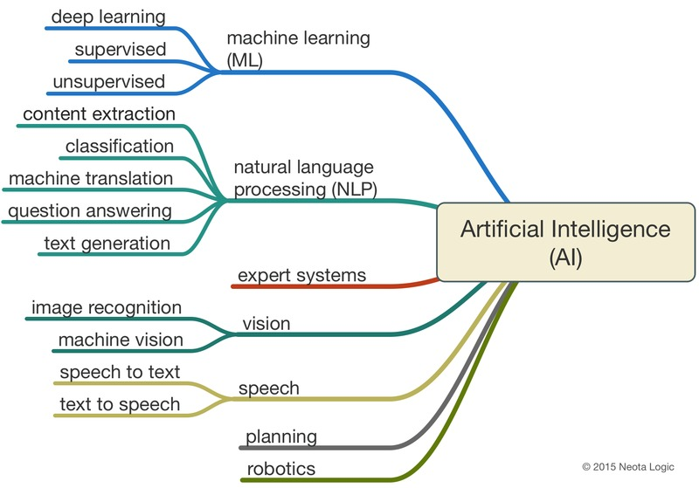
Focus: AI and ML
AI
ARTIFICIAL INTELLIGENCE
Source: neotalogic 2015
Notes:
You could all probably agree that these are the main sub-fields in AI

Slide 12

Focus: ML Categories
Supervised learning: The algorithm is presented with example inputs and their desired outputs, given by a "teacher", and the goal is to learn a general rule that maps inputs to outputs.
Unsupervised learning: No labels are given to the learning algorithm, leaving it on its own to find structure in its input. Unsupervised learning can be a goal in itself (discovering hidden patterns in data) or a means towards an end (feature learning).
Reinforcement learning: A computer program interacts with a dynamic environment in which it must perform a certain goal (such as driving a vehicle), without a teacher explicitly telling it whether it has come close to its goal. Another example is learning to play a game by playing against an opponent.
Notes:
ML has three main categories, although some argue that semi-supervised rests somewhere between supervised and unsupervised. We will concern ourselves mainly with these three throughout this course.

Slide 13
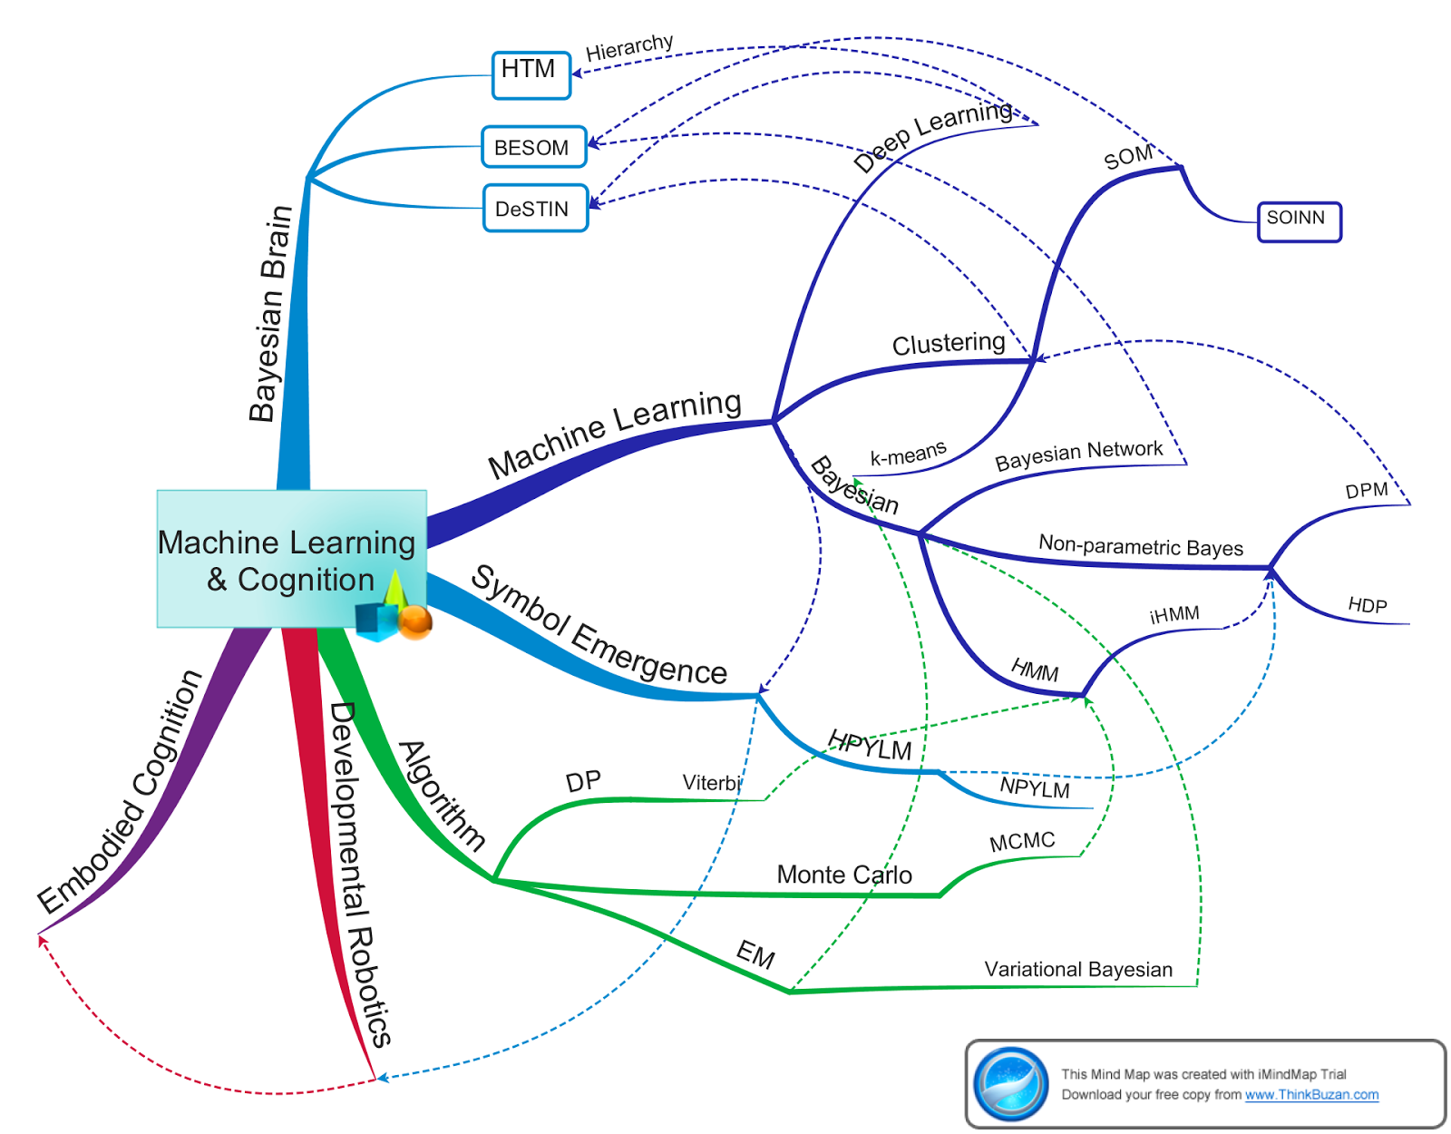
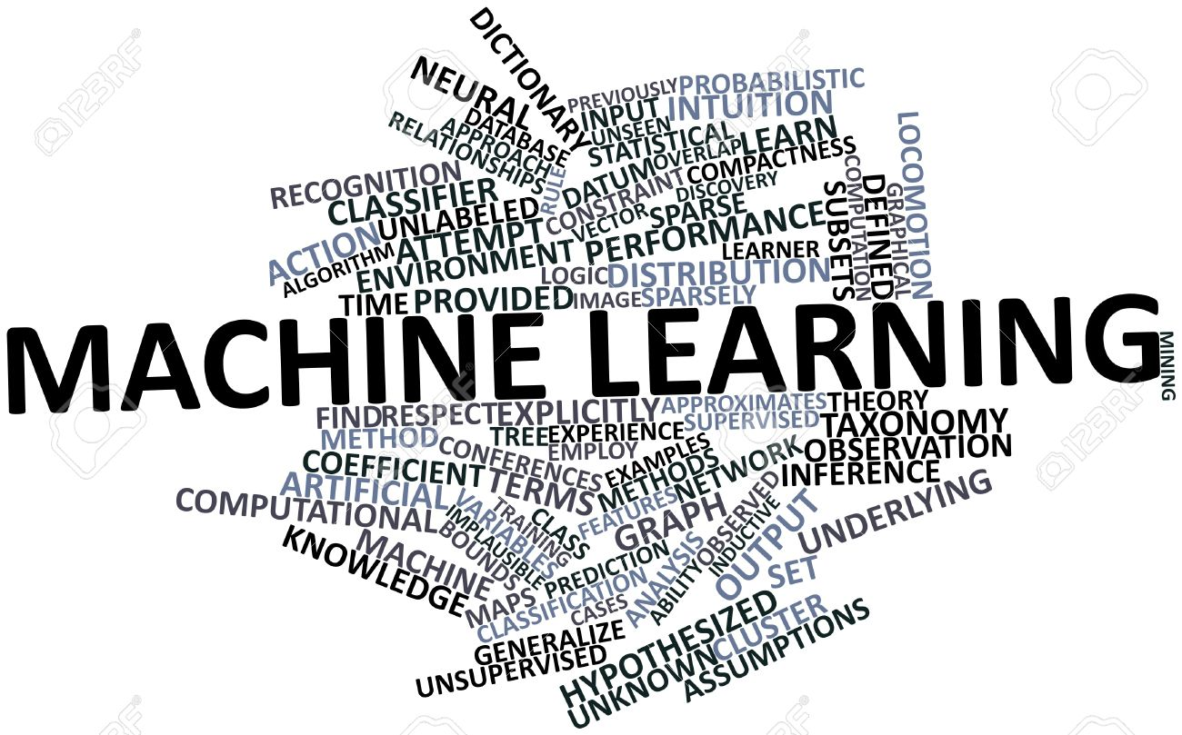
Focus: ML Representations (i.e. Algorithms)
MACHINE LEARNING REPRESENTATIONS
Decision Trees
Clustering Methods
Regression
Dimensionality Reduction
Ensemble Methods
Instance Based Learning
Association Rule Based Learning
Bayesian Methods
Kernel Methods
NN, ANN, CNN (leads to Neurocomputing)
Deep Learning
Source: 123rf.com
Notes:
Beyond these 3 categories, most literature sources lump all the ML approaches into one huge confusing category … which if you looking at ML for the first time it comes across like this graphic.
That is mostly to avoid some of the issues when attempting to discern or make distinctions between ML approaches and where they fit in the 3 categories. I have taken a stab at labeling the more popular model representations and algorithm approaches and providing some context to where they fit in the ML family.
Classification techniques are the largest in the ML family but as you can see these techniques are not exclusive to sub-categories, overlap again exists, and algorithms are often modified or combined for different goals. Even regression shares some of the classification approaches, but let’s not get hung up on how we classify the techniques, and instead focus on the technique itself to understand how it performs for the problem and data.

Slide 14
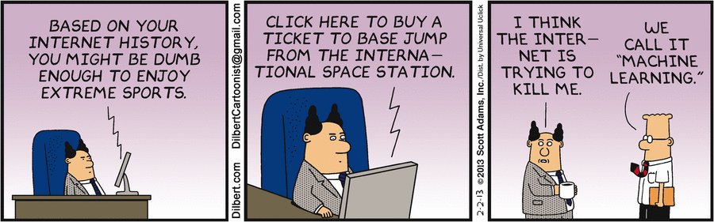
Around the Room
Story (Part I): Automation and Control → Robotic Vision → Imaging → Medical Imaging … Machine Learning
Story Time (Part II): Your ML Exposure / Experience or “What got you interested in ML, AI, Data Science …”
Notes:
Now that you have seen a bit of ML, you might be able to relate your experience here at BAE or your previous projects.

Slide 15
Anatomy of a ML “Black Box”
Supervised Learning Model
Labeled Datasets
LABELS
LABELS
MACHINE LEARNING
ALGORITHM
TRAINING
LABELS
INPUT DATA
features
“Train the Model”
INPUT DATA
INPUT DATA
FEATURE EXTRACTOR
Creates
Stats
INPUT DATA
features
INPUT DATA
INPUT DATA
FEATURE EXTRACTOR
LABELS
LABELS
CLASSIFIER MODEL
LABELS
TEST
(i.e., predicted labels vs expected label)
(aka, prediction model, learning model)
Notes:
ML prediction models are trained by showing them many labeled instances or rows of data. The prediction models are then used to make predictions about new instances. This process is commonly referred to as supervised machine learning.
In supervised learning approaches, teachers provide judgments about the data using labels. These judgments are collected into a set of "labeled data sets “.
The labelling process is performed on a dataset that is cleaned, conditioned, and curated to be free of errors that would lead to poor results.
In some cases the data input is already in a form consumable by the ML algorithm. In other cases, the raw data needs to go through a feature selection and extraction process to be consumable by the ML algorithm. One example is image data that if your goal is face recognition, regions of the image are extracted and labeled as eyes, nose, mouth, etc.
The machine learner uses the "training set" data (raw or derived features) to learn how to predict the provided labels (i.e. learns to replicate human judgments) and a "prediction model" is created. This prediction model can be used to automatically label new instances.
To measure the performance of your newly trained model, input data, again either raw or derived features, are input into the model. Although the test data also have labels, these labels are not known or presented to the model. Instead the model predicts the labels for every instance of the test data set. These "predicted labels" are compared to the apriori “provided labels" to generate statistics about the your model's performance.
This is your opportunity to tweak the parameters of your model to optimize as best possible to achieve a satisfactory performance. Methods include increasing your training set for more instances/samples, swapping test and training data sets, etc., all of which have their own issues, but this will become more apparent in the linear regression example. So at a high level, iterate the train and test of your prediction model.

Slide 16
Anatomy of a ML “Black Box”
Supervised Learning Model
Labeled Datasets
LABELS
LABELS
MACHINE LEARNING
ALGORITHM
TRAINING
LABELS
(e.g., 100 instances)
INPUT DATA
features
“Train the Model”
INPUT DATA
INPUT DATA
FEATURE EXTRACTOR
60% Train
(Train)
Real-World Raw Input Data
40% Test
(Test)
Creates
Stats
INPUT DATA
features
INPUT DATA
INPUT DATA
FEATURE EXTRACTOR
LABELS
LABELS
CLASSIFIER MODEL
LABELS
TEST
(i.e., predicted labels vs expected label)
(aka, prediction model, learning model)
INPUT DATA
features
INPUT DATA
(infinite instances)
INPUT DATA
FEATURE EXTRACTOR
LABELS
LABELS
PRODUCTION
LABELS
(i.e., predicted labels)
Notes:
If you are lucky enough to find an existing dataset that has been labeled as your data input, it is customary to split the labeled dataset into a "training set" and "test set".
For example, if the dataset includes 100 samples, you might arbitrarily use 60% for the "training set" for the machine learner to learn from, and set aside 40% of the data for the "test set" for model evaluation.
If you do not have a Real World dataset, then you have to create a dataset for the same purpose.
In either approach, you train and test your model, iterate train&test until you have reached your stopping point (e.g, performance criteria, frustration, exhaustion, time deadline, funding ceiling, etc.) and with a “prediction model” optimized to a satisfactory level the model is used in production systems to classify real world data to produce labels.

Slide 17

Anatomy of a ML “Black Box”
Supervised Learning Model
Instance | Feature 1 2 3 4 … N |  |  |  |  |  | Label
1 | X(1,1) | X(1,2) | X(1,3) | X(1,4) |  | X(1,N) | Car
2 | X(2,1) | X(2,2) | X(2,3) | X(2,4) |  | X(2,N) | Truck
3 | X(3,1) | X(3,2) | X(3,3) | X(3,4) |  | X(3,N) | Jeep
: | : | : | : | : |  | : | :
M | X(M,1) | X(M,2) | X(M,3) | X(M,4) |  | X(M,N) | Pickup
Labeled Datasets
COMPARE
LABELS
LABELS
MACHINE LEARNING
ALGORITHM
TRAINING
LABELS
Inst. | Feature 1 2 3 4 … N |  |  |  |  |  | Label | Label- Pred.
M+1 | X(M+1,1) | X(M+1,2) | X(M+1,3) | X(M+1,4) |  | X(M+1,N) | Pickup | Pickup
M+2 | X(M+2,1) | X(M+2,2) | X(M+2,3) | X(M+2,4) |  | X(M+2,N) | Jeep | Jeep
M+3 | X(M+3,1) | X(M+3,2) | X(M+3,3) | X(M+3,4) |  | X(M+3,N) | Pickup | Car
: | : | : | : | : |  | : | : | :
100 | X(100,1) | X(100,2) | X(100,3) | X(100,4) |  | X(100,N) | Pickup | Pickup
(e.g., 100 instances)
INPUT DATA
features
“Train the Model”
INPUT DATA
INPUT DATA
FEATURE EXTRACTOR
60% Train
Instance | Feature 1 2 3 4 … N |  |  |  |  |  | Label
M+1 | X(M+1,1) | X(M+1,2) | X(M+1,3) | X(M+1,4) |  | X(M+1,N) | Pickup
M+2 | X(M+2,1) | X(M+2,2) | X(M+2,3) | X(M+2,4) |  | X(M+2,N) | Jeep
M+3 | X(M+3,1) | X(M+3,2) | X(M+3,3) | X(M+3,4) |  | X(M+3,N) | Pickup
: | : | : | : | : |  | : | :
100 | X(100,1) | X(100,2) | X(100,3) | X(100,4) |  | X(100,N) | Pickup
(Train)
Real-World Raw Input Data
40% Test
(Test)
Creates
Stats
INPUT DATA
features
INPUT DATA
INPUT DATA
FEATURE EXTRACTOR
LABELS
LABELS
CLASSIFIER MODEL
LABELS
TEST
(i.e., predicted labels vs expected label)
Output
(aka, prediction model, learning model)
Instance | Feature 1 2 3 4 … N
101 | X(101,1) | X(101,2) | X(101,3) | X(101,4) |  | X(101,N)
102 | X(102,1) | X(102,2) | X(102,3) | X(102,4) |  | X(102,N)
103 | X(103,1) | X(103,2) | X(103,3) | X(103,4) |  | X(103,N)
: | : | : | : | : |  | :
Infinity | X(inf,1) | X(inf,2) | X(inf,3) | X(inf,4) |  | X(inf,N)
Inst. | Feature 1 2 3 4 … N |  |  |  |  |  | Label- Prediction
101 | X(101,1) | X(101,2) | X(101,3) | X(101,4) |  | X(101,N) | Jeep
102 | X(102,1) | X(102,2) | X(102,3) | X(102,4) |  | X(102,N) | Car
103 | X(103,1) | X(103,2) | X(103,3) | X(103,4) |  | X(103,N) | Pickup
: | : | : | : | : |  | : | :
Infinity | X(inf,1) | X(inf,2) | X(inf,3) | X(inf,4) |  | X(inf,N) | Car
INPUT DATA
features
INPUT DATA
(infinite instances)
INPUT DATA
FEATURE EXTRACTOR
LABELS
LABELS
PRODUCTION
LABELS
(i.e., predicted labels)
Source: kdnuggets.com
Notes:
This illustrates where labels are used and not used.
In the training phase, labels in the last column are ingested along with M number of feature vector data of dimension N
In the test phase, labels in the last column are withheld for the remaining (100-M) number of feature vector data of dimension N, and compared to the predicted labels output from the model.
In the production phase, no labels are provided to the model that ingest any number of N dimension feature vectors, and predict a label, hopefully more right than wrong.

Slide 18
SW with “Machine Learning” elements
Several SW tools are available to exercise ML techniques: (in no particular order)
MATlab
Azure
SAS
SPSS
Weka
R
Ruby
Scala
H2O
Mlib
Aforge
Statistica
MADlib
HaLoop
Pregel
Arago
libSVM
Spring XD
Shogun
Mahout
Pentaho
ConvNetJS
TensorFlow
Spark MLlib
RevolutionR
RapidMiner
CUDA-convert
Cloudera Oryx
SourceForge
Google GO/GOLearn
Python Scikit/PyBrain/mlpy
Etc.
Project: scikit-learn GitHub: https://github.com/scikit-learn/scikit-learn
Project: Shogun GitHub: https://github.com/shogun-toolbox/shogun
Project: Accord Framework/AForge.net GitHub: https://github.com/accord-net/framework/
Project: Cloudera Oryx GitHub: https://github.com/cloudera/oryx
Project: GoLearn GitHub: https://github.com/sjwhitworth/golearn
Project: ConvNetJS GitHub: https://github.com/karpathy/convnetjs
Reference “Practical Machine Learning – Sunila Gallapudi” for how to setup some of these ML SW tools and libraries, as well as select and trade ML methods.
Notes:
A search for ML tools and SW will yield numerous results from which you can choose the best for your application
This course aims not at exercising the tools, rather assisting you in selecting the right tool for your problem space by describing where the ML algorithms are well suited and ill-suited to the situation.
Essentially, describe for you what is under the hood of each of the ML techniques so you have an understanding of how it works, where it could succeed, where it could fail, and perhaps instill in you a confidence to navigate the ML domain for the solution your project is searching for.
I do not have experience with these SW offerings since typically, the past projects I have worked on at BAE do not permit the inclusion of opensource SW in certain operational military systems. That is not the case for all military and intelligence programs today, and some opensource SW is allowable depending if it has passed scrutiny by the appropriate government agencies and groups.
Some of these tools employ ML techniques might be more focused on other areas like data mining as implied in the name.
If you are so motivated, take a look at some projects that provide open source software projects and packages as a springboard into ML

Slide 19
Supervised Machine Learning
An example of Linear Regression
Regression – design of a ML algorithm to predict a variable that is continuous valued
Classification - design of a ML algorithm to predict a variable that is discrete valued
1M
900k
Regression Goal:
Learn what makes the price a certain value from the training data (sqft & price)
ML Alg then produces more “right” answers based on input data, where we do not already know the price.
800k
700k
SD Housing Prices ($)
600k
500k
Training Data
Straight Line Fit
Second order polynomial
400k
1000
1500
2000
2500
3000
3500
4000
4500
5000
SD House Size in ft²
Notes:
Real Estate pricing is a simple example and gut feel is an easy guide to pricing a house. But the point I want to make is, some data sets don’t offer easy visualization, gut feel, or intuition in the outcome, so you need to trust your ML implementation.
Take for example, as input volume increases the human’s ability to price each housing input is challenging and is one reason for designing a ML algorithm to predict house prices rapidly.
Secondly, the example only used one feature and it was a 2 dimensional problem. Here the training set is square footage vs price, where area is the input and price is the output. If the input features includes not only area, but also location, view, # bedrooms, # baths, # floors, # acres, proximity to schools, stores, work, etc. the ML algorithm becomes more complex, and at the same time is less intuitive to the real estate agent. Although realtors think they can realistically juggle multiple factors in pricing a house, visualization is no longer possible due to the multi-dimensional feature space.
.
Whatever the underlying ML algorithm complexity, the result is a decision boundary that is continuous and provides the “right” prediction to an input. Depending on your ML alg the price you might command for your 3200 sqft house in san diego is predicted to be between 790K-860K.
If you decide to move away from an underlying regression model that is first order, linear fit, to a more complex model that fits your data “better” you will see it changes the prediction for the same input value(s).

Slide 20
Supervised Machine Learning
A Classification example
Regression – design of a ML algorithm to predict a variable that is continuous valued
Classification - design of a ML algorithm to predict a variable that is discrete valued
Malignant Tumor ?
Training Data
1 (YES)
Classes
Benign
Benign
Malignant
0 (NO)
Malignant
Tumor Size
Tumor Size
0
Benign
1
Type 1
2
Type 2 & 3
3
Type 4
Classification:
Classify data into one of two discrete classes – no in between, either malignant or not
In classification problems, can have a discrete number of possible values for the output
Classification:
Classify data into one of two discrete classes – no in between, either malignant or not
Feature vector
Feature(0) = tumor size
feature_length = 1

Slide 21
Feature Vectors and Dimension
Re-using the classification example
feature_length = 1
Classes
Feature vector
Feature(0) = tumor size
Benign
Malignant
Tumor Size
Notes:
You should get this. Let’s build on the previous example to explain the relationship between the number of feature vectors and dimension of your problem space. In lower dimension the problem may be easy to visualize and aid in interpreting the results. Here is a one dimensional problem, easy to visualize and construct a ML algorithm for thresholds to separate the problem space into classes using benign and malignant labels. Increasing the dimension of the ML algorithm however is a benefit to class separation as we see in the next slide.

Slide 22
Feature Vectors and Dimension
Re-using the classification example
feature_length = 2
Classes
Feature vector
Feature(0) = tumor size
Benign
Feature(1) = tumor location
Malignant
Tumor Location
Tumor Size
Notes:
Notice by adding another feature to the data , the classes might become separable. In this case, it is becoming more linear separable but not quite. We can still visualize in two dimensions to aid us ML alg evaluation

Slide 23
Feature Vectors and Dimension
Re-using the classification example
2
Classes
8
6
7
5
4
3
feature_length =
Feature vector
Feature(0) = tumor size
Benign
Feature(1) = tumor location
Malignant
Feature(2) = lymph node
Feature(3) = metastasis
Feature(4) = grade
Feature(5) = tumor marker - Urine
Feature(6) = tumor marker - Blood
Feature(7) = tumor marker - Tissue
Hyperplane:
Decision boundary or decision surface that partitions the underlying vector space into two sets, one for each class.
Tumor Location
Lymph Node
Tumor Size
Notes:
Adding yet another feature to the data it is clear that the data is separable, here by a plane in 3-dimensional space, and is still also visualizable.
Show of hands, how many of you are able to visualize in more than 5 dimensions?
However, adding more features you no longer have the luxury of visualization and depend very heavily on the on the ML algorithm to learn the feature data and create a decision surface (i.e., hyperplane) commensurate with the dimension of your problem space minus one (i.e., feature vector dimension - 1)

Slide 24
Classification of new unseen inputs
Re-using the classification example
feature_length = 3
Feature vector
Feature(0) = tumor size
Feature(1) = tumor location
Feature(2) = lymph node
Lymph Node
Classifier:
will label points on one side of the decision surface as belonging to one class and all those on the other side as belonging to the other class.
If the decision surface is a hyperplane, then the classification problem is linear, and the classes are linearly separable.
Prediction
Malignant Region
Tumor Location
Benign Region
Tumor Size

Slide 25
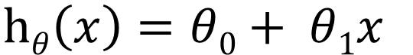
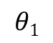
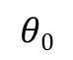
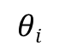
Demystifying the ML “Black Box”
Putting the learning algorithm into perspective … re-use the linear regression problem
TERMINOLOGY
Supervised Learning Model
m = number of training samples
n = number of features
LABELS
x = input variables / features
LABELS
MACHINE LEARNING
ALGORITHM
LABELS
y(i)
y = output variables / “target” variables
(x,y) = single training example
INPUT DATA
features
“Train the Model”
INPUT DATA
x(i)
INPUT DATA
FEATURE EXTRACTOR
(x^{i},y^{i}) = specific example (i^{th} training example) where “i” is an index into to the training set
y
(Train)
x
Creates
x(i)
CLASSIFIER MODEL
Hypothesis
“h”
Estimated “y”
Instance (i) | Input x(i) | Output y(i)
1 | x(1) | y(1)
2 | x(2) | y(2)
3 | x(3) | y(3)
: | : | :
m | x(m) | y(m)
m
TERMINOLOGY
$$hθ\left(x\right)=θ0+ θ1x$$
$$θi$$
are parameters
$$θ0$$
is the zero condition
h is a linear function of x
(i.e., y is a linear function of x)
h is a “y imitator”
$$θ1$$
is the gradient
Notes:
Recall this supervised learning model to train a ML algorithm
Here is some terminology to be used
Since only one value of x is used in training the feature vector is length 1 and is directly input into the system
The model we have chosen for the linear regression example is a linear model with one variable – univariate linear regression model. However this is not the only model you can select, but that is your design choice
The hypothesis takes in some variable x, uses the parameters determined by the learning system, and outputs a prediction based on that input

Slide 26
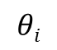

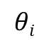
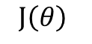
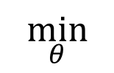
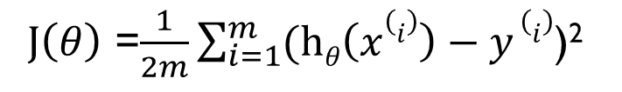
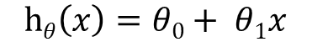
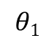
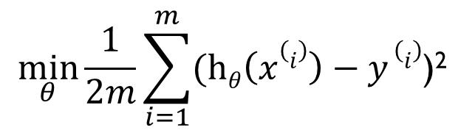
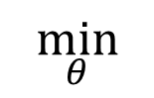
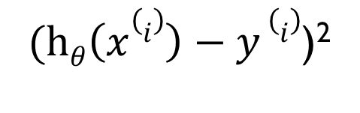
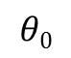

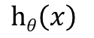
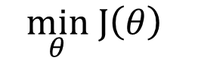
Demystifying the ML “Black Box”
Putting the learning algorithm into perspective … re-use the linear regression problem
Supervised Learning Model
“Train the Model”
MACHINE LEARNING ALGORITHM
Concept: want an algorithm that generates parameters so is close to “y” for our training examples → COST FUNCTION
y(i)
$$θi$$
COST FUNCTION
$$hθ\left(x\right)$$
(Train)
$$J\left(θ\right)$$
x(i)
Instance (i) | Input x(i) | Output y(i)
1 | x(1) | y(1)
2 | x(2) | y(2)
3 | x(3) | y(3)
: | : | :
m | x(m) | y(m)
One approach to a cost function:
1. Minimize the difference
$$\min_{θ}$$
$$\min_{θ}$$
$(hθ\left(x(i)\right)−y$ $(i)$)²
$$(hθ\left(x\right)−y)$$
$$\left(hθ\left(x\right)−y\right)2$$
Creates
2. Sum the differences
Hypothesis
“h”
$$\min_{θ}\frac{1}{2m}\sum_{i=1}^{m}{(hθ\left(x(i)\right)−y (i)\text{)}\text{2} }$$
TERMINOLOGY
$$θi$$
are parameters
3. Define the cost function
$$θ0$$
is the zero condition
$$hθ\left(x\right)=θ0+ θ1x$$
$J\left(θ\right)$ =$\frac{1}{2m}\sum_{i=1}^{m}{(hθ\left(x(i)\right)−y (i)\text{)}\text{2} }$
$$θ1$$
is the gradient
4. ML GOAL: Minimize the cost function
$$\min_{θ} J\left(θ\right)$$
Notes:
What is important here is understanding how the machine learning algorithm determines the parameters of your model
Let’s open the Machine Learning Algorithm box to understand how it optimizes the parameters based on your available training data.
Your objective is to develop a hypothesis that closely approximates your y output for your training samples. One approach is to minimize the difference between h and y, let’s walk through the math.
Define your cost function which examines all the samples in our training set. The cost function is also called the squared error cost function, which is reasonable for most regression problems, but not the only one.
Now let’s talk about different approaches to minimizing the cost function

Slide 27
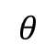
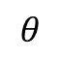
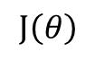

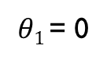
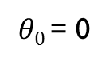
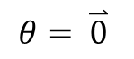
Demystifying the ML “Black Box”
Putting the learning algorithm into perspective … re-use the linear regression problem
Supervised Learning Model
“Train the Model”
MACHINE LEARNING ALGORITHM
Concept: select an optimization method which searches for the “best” solution to the minimization of
y(i)
(Train)
COST FUNCTION
OPTIMIZATION TECHNIQUE
$$J\left(θ\right)$$
x(i)
Instance (i) | Input x(i) | Output y(i)
1 | x(1) | y(1)
2 | x(2) | y(2)
3 | x(3) | y(3)
: | : | :
m | x(m) | y(m)
One approach to a optimization:
A search algorithm called Gradient Descent
INITIALIZE
Initialize the starting point of for the search algorithm; say namely,
$$θ$$
$$θ= \overset{⃑}{0}$$
Creates
Hypothesis
“h”
$θ0$= 0
$θ1$= 0
Keep changing to reduce to its minimum
$$θ$$
$$J\left(θ\right)$$
TERMINOLOGY
$$θi$$
are parameters
$$θ0$$
is the zero condition
$$hθ\left(x\right)=θ0+ θ1x$$
$$θ1$$
is the gradient

Slide 28
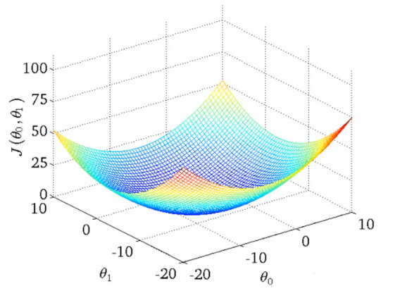
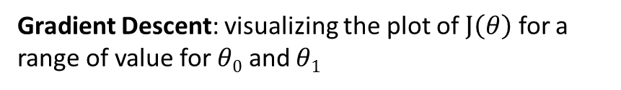
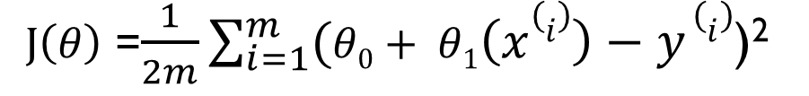
Demystifying the ML “Black Box”
Putting the learning algorithm into perspective … re-use the linear regression problem
Supervised Learning Model
“Train the Model”
$J\left(θ\right)$ =$\frac{1}{2m}\sum_{i=1}^{m}{(θ0+ θ1\left(x(i)\right)−y (i)\text{)}\text{2} }$
y(i)
MACHINE LEARNING ALGORITHM
Gradient Descent: visualizing the plot of $J\left(θ\right)$ for a range of value for $θ0$ and $θ1$
(Train)
COST FUNCTION
OPTIMIZATION TECHNIQUE
x(i)
Instance (i) | Input x(i) | Output y(i)
1 | x(1) | y(1)
2 | x(2) | y(2)
3 | x(3) | y(3)
: | : | :
m | x(m) | y(m)
INITIALIZE
Creates
Hypothesis
“h”
TERMINOLOGY
$$θi$$
are parameters
$$θ0$$
is the zero condition
$$hθ\left(x\right)=θ0+ θ1x$$
$$θ1$$
is the gradient
Notes:
In the cases where the feature dimension is low and visualization is possible, you could convince yourself of the results of minimization, specifically gradient descent, by plotting the cost function values for the specific training set for a range of parameter values.
For purposes of illustration we will do this here to describe how gradient descent works. Fixing one parameter value in one dimension and varying the other parameter generates a quadratic, and repeatedly creates this quadratic looking surface.

Slide 29
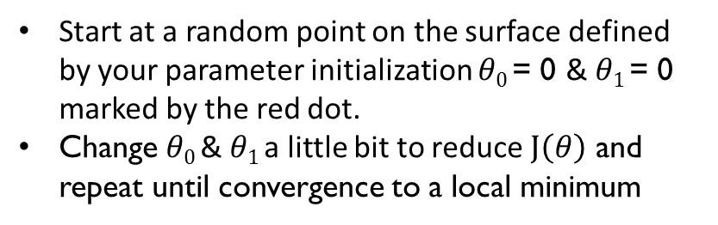
Demystifying the ML “Black Box”
Putting the learning algorithm into perspective … re-use the linear regression problem
Supervised Learning Model
“Train the Model”
$J\left(θ\right)$ =$\frac{1}{2m}\sum_{i=1}^{m}{(θ0+ θ1\left(x(i)\right)−y (i)\text{)}\text{2} }$
y(i)
MACHINE LEARNING ALGORITHM
Gradient Descent: visualizing the plot of $J\left(θ\right)$ for a range of value for $θ0$ and $θ1$
(Train)
COST FUNCTION
OPTIMIZATION TECHNIQUE
x(i)
Start at a random point on the surface defined by your parameter initialization $θ0$= 0 & $θ1$= 0 marked by the red dot.
Change $θ0$& $θ1$a little bit to reduce $J\left(θ\right)$ and repeat until convergence to a local minimum
Instance (i) | Input x(i) | Output y(i)
1 | x(1) | y(1)
2 | x(2) | y(2)
3 | x(3) | y(3)
: | : | :
m | x(m) | y(m)
INITIALIZE
Creates
Hypothesis
“h”
TERMINOLOGY
$$θi$$
are parameters
$$θ0$$
is the zero condition
$$hθ\left(x\right)=θ0+ θ1x$$
$$θ1$$
is the gradient
Notes:
Starting anywhere on the curve, the intent of the search function is to move downhill until the minimum is found. Easy right, well in this case it is pretty easy to see where the minimum is.
NOTE: Gradient descent does not require you to generate a surface describing the cost function in order to work.

Slide 30
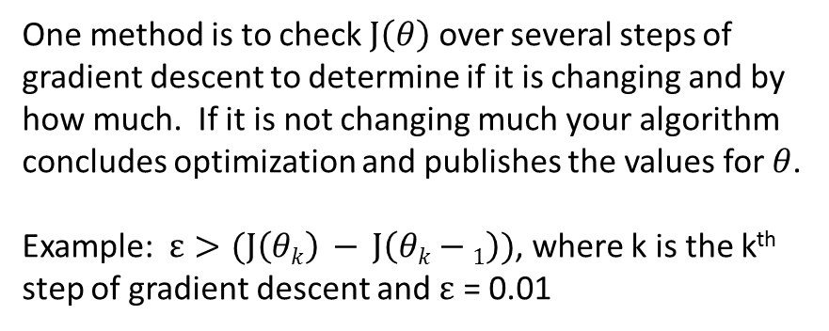
Demystifying the ML “Black Box”
Putting the learning algorithm into perspective … re-use the linear regression problem
Supervised Learning Model
“Train the Model”
Convergence: you need to define your stopping criteria as to when the cost function is “sufficiently” optimized (i.e., minimized). There are several approaches to define convergence.
y(i)
MACHINE LEARNING ALGORITHM
(Train)
COST FUNCTION
OPTIMIZATION TECHNIQUE
x(i)
One method is to check $J\left(θ\right)$ over several steps of gradient descent to determine if it is changing and by how much. If it is not changing much your algorithm concludes optimization and publishes the values for $θ$.
Example: $ε>(J\left(θk\right) − J\left(θk−1\right))$, where k is the k^{th} step of gradient descent and $ε$ = 0.01
Instance (i) | Input x(i) | Output y(i)
1 | x(1) | y(1)
2 | x(2) | y(2)
3 | x(3) | y(3)
: | : | :
m | x(m) | y(m)
INITIALIZE
STOPPING CRITERIA
Creates
x(i)
Hypothesis
“h”
Estimated “y”
TERMINOLOGY
$$θi$$
are parameters
$$θ0$$
is the zero condition
$$hθ\left(x\right)=θ0+ θ1x$$
$$θ1$$
is the gradient

Slide 31
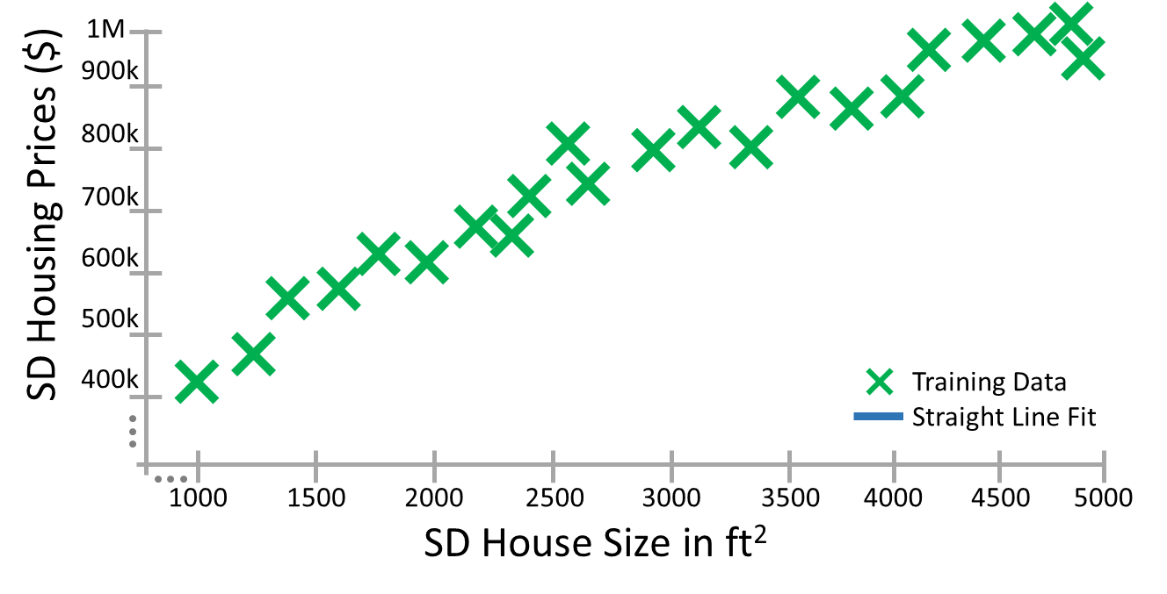
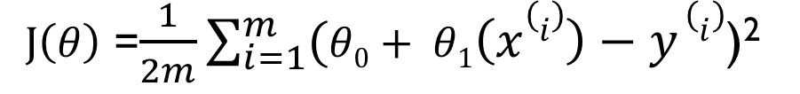
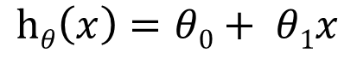
Demystifying the ML “Black Box”
Putting the learning algorithm into perspective … re-use the linear regression problem
$$hθ\left(x\right)=θ0+ θ1x$$
$J\left(θ\right)$ =$\frac{1}{2m}\sum_{i=1}^{m}{(θ0+ θ1\left(x(i)\right)−y (i)\text{)}\text{2} }$
Step 6
Step 5
Step 4
Step 3
Step 2
Initialization
Step 1
Step 2
Step 1
Step 3
Step 4
Step 5
Step 6
Initialization
Notes:
At each step, the “Batch Gradient Descent” examines all the training data in evaluating in which direction and how big of a step, gradient descent makes towards searching for the minimum.

Slide 32
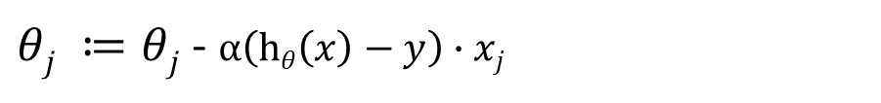
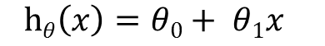
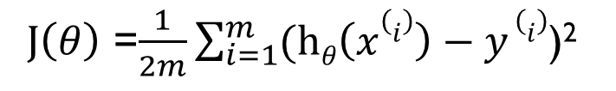
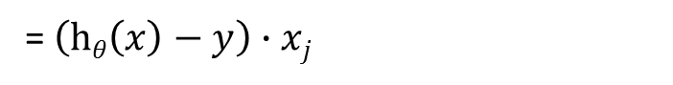
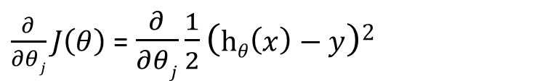
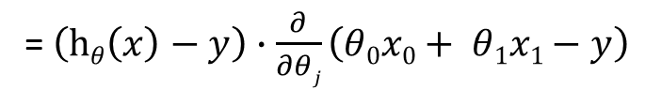
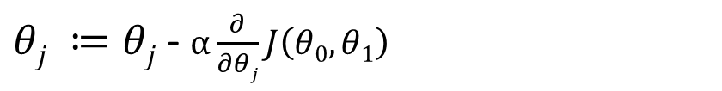
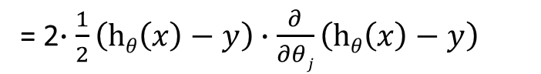
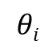
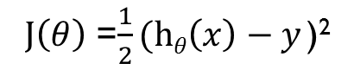
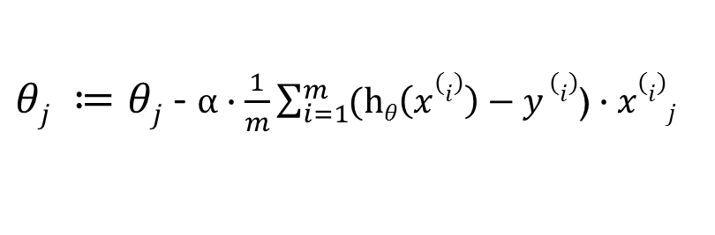
Demystifying the ML “Black Box”
Putting the learning algorithm into perspective … re-use the linear regression problem
“Train the Model”
Gradient Descent:
Supervised Learning Model
At every step (i.e., iteration) of gradient descent we simultaneously update the values for the parameters:
y(i)
MACHINE LEARNING ALGORITHM
(Train)
COST FUNCTION
OPTIMIZATION TECHNIQUE
$θj ≔θj$ - $α\frac{∂}{∂θj}J\left(θ0,θ1\right)$
x(i)
for j = [0..1]
Instance (i) | Input x(i) | Output y(i)
1 | x(1) | y(1)
2 | x(2) | y(2)
3 | x(3) | y(3)
: | : | :
m | x(m) | y(m)
Where $α$is the learning rate (i.e., step size)
INITIALIZE
STOPPING CRITERIA
$\frac{∂}{∂θj}J\left(θ\right)$ = $\frac{∂}{∂θj}\frac{1}{2}\left(hθ\left(x\right)−y\right)2$
= 2$∙\frac{1}{2}\left(hθ\left(x\right)−y\right)∙\frac{∂}{∂θj}\left(hθ\left(x\right)−y\right)$
Creates
x(i)
Hypothesis
“h”
= $\left(hθ\left(x\right)−y\right)∙\frac{∂}{∂θj}\left(θ0x0+ θ1x1−y\right)$
Estimated “y”
TERMINOLOGY
= $\left(hθ\left(x\right)−y\right)∙xj$
$$θi$$
are parameters
$$hθ\left(x\right)=θ0+ θ1x$$
$θj ≔θj$ - $α\left(hθ\left(x\right)−y\right)∙xj$
$J\left(θ\right)$ =$\frac{1}{2m}\sum_{i=1}^{m}{(hθ\left(x(i)\right)−y (i)\text{)}\text{2} }$
for j = [0..1]
$θj ≔θj$ - $α∙\frac{1}{m}\sum_{i=1}^{m}{(hθ\left(x(i)\right)−y (i)\text{)}}∙x(i)j$
For one training sample m =1 ,
$J\left(θ\right)$ =$\frac{1}{2}(hθ\left(x\right)−y \text{)}\text{2}$
general form using m training samples
Notes:
Let’s show how the parameters of the learning algorithm get “batch updated”.
Recall the equations for your predictor/hypothesis and the cost function
Simplify J by considering one training sample.
Applying the chain rule the derivative simplifies and is reinserted into the parameter update equation

Slide 33
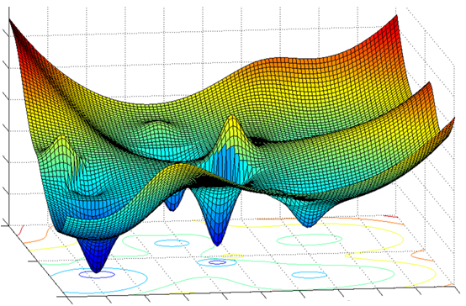
Gradient Descent
… appreciating the complexities of gradient descent
Initialization
Initialization
Initialization
Initialization
Initialization
Local Minimum
Global Minimum
Notes:
As this surface indicates for a particular cost function, there are several local minimums but only one global minimum, at which the parameters of your ML algorithm is optimum. Searching for the global minimum is the challenge in developing the most accurate hypothesis or predictor. Since this is considered the secret sauce “What do you suggest in searching this surface?”
Correct answers include:
Randomly selecting the initialization point
Any method that advertises search without getting stuck in local minima (e.g., genetic algorithms with mutation and crossover)

Slide 34
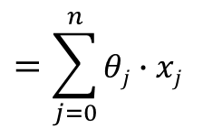
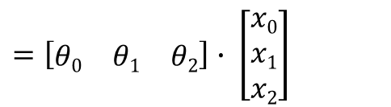





Adding a feature to the input
… but you need to have faith in your search technique since you can no longer visualize
y(i)
Adding several more features to the input, specifically a total of n features
features
MACHINE LEARNING ALGORITHM
Instance (i) | Feature – x(i, feature) 1 2 3 4 … n |  |  |  |  |  | Output y(i)
1 | x(1,1) | x(1,2) | x(1,3) | x(1,4) |  | x(1,n) | y(1)
2 | x(2,1) | x(2,2) | x(2,3) | x(2,4) |  | x(2,n) | y(2)
3 | x(3,1) | x(3,2) | x(3,3) | x(3,4) |  | x(3,n) | y(3)
: | : | : | : | : |  | : | :
m | x(m,1) | x(m,2) | x(m,3) | x(m,4) |  | x(m,n) | y(m)
COST FUNCTION
OPTIMIZATION TECHNIQUE
x^{(i)}_{j}
(i) | Input x(i,j)
1 | x(1,1)
2 | x(2,1)
3 | x(3,1)
: | :
m | x(m,1)
Output y(i)
y(1)
y(2)
y(3)
:
y(m)
Input x(i,j)
x(1,2)
x(2,2)
x(3,2)
:
x(m,2)
Output y(i)
y(1)
y(2)
y(3)
:
y(m)
INITIALIZE
STOPPING CRITERIA
Creates
$$hθ\left(x\right)=θ0x0+ θ1x1+ ⋯+θnxn$$
Hypothesis
“h”
$$=\sum_{j=0}^{n}{θj}∙xj$$
$=\left[\begin{matrix}θ0 & θ1 & \begin{matrix}⋯ & θn\end{matrix}\end{matrix}\right]$ $∙ \left[\begin{matrix}x0 \\ x1 \\ \begin{matrix}⋮ \\ xn\end{matrix}\end{matrix}\right]$
$$hθ\left(x\right)=θ0x0+ θ1x1+ θ2x2$$
define x₀ = 1
$$=\sum_{j=0}^{2}{θj}∙xj$$
$=\left[\begin{matrix}θ0 & θ1 & θ2\end{matrix}\right]$ $∙ \left[\begin{matrix}x0 \\ x1 \\ x2\end{matrix}\right]$
$$=θT∙x$$
$$=θT∙x$$
$θj ≔θj$ - $α∙\frac{1}{m}\sum_{i=1}^{m}{(hθ\left(x(i)\right)−y (i)\text{)}}∙x(i)j$
for j = [0..n]
Notes:
Adding one feature, we can represent the function in vector notation. We have now lost the crutch of visualization as the dimensions increase. This is no longer a linear regression problem, rather quadratic. If you need a refresher on vector and matrix notation, please do so.
We can now apply the same techniques for polynomial regression

Slide 35
















Closed form solution
… solving parameters more directly than using an incremental or iterative approach
Let’s introduce a notation for derivatives of matrices
$$hθ\left(x\right)=θ0x0+ θ1x1+ ⋯+θnxn$$
J is a cost function in vector notation form
$∇θJ$
is the derivative of the vector J w.r.t. $θ$
is also a vector
$=θT∙x$
$$∇θJ= \left[\begin{matrix}\frac{∂}{∂θ0}J \\ ⋮ \\ \frac{∂}{∂θn}J\end{matrix}\right]$$
$$=x0θ0+x1θ1+ ⋯+xnθn$$
$=x^{T}θ$
n features
$$x(i)$$
n+1
X $=\left[\begin{matrix}{(x(1))}^{T} \\ {(x(2))}^{T} \\ \begin{matrix}⋮ \\ {(x(m))}^{T}\end{matrix}\end{matrix}\right]$
$$∈Real$$
n+1
$$∈Real$$
m training samples
“Batch” Gradient Descent can be written as:
n+1
$θ ≔θ$ - $α∙∇θJ$
$$θ ∈Real$$
X$θ=\left[\begin{matrix}{(x(1))}^{T} \\ {(x(2))}^{T} \\ \begin{matrix}⋮ \\ {(x(m))}^{T}\end{matrix}\end{matrix}\right]θ$
$$=\left[\begin{matrix}{(x(1))}^{T}θ \\ {(x(2))}^{T}θ \\ \begin{matrix}⋮ \\ {(x(m))}^{T}θ\end{matrix}\end{matrix}\right]$$
$$=\left[\begin{matrix}hθ(x(1)) \\ hθ(x(2)) \\ \begin{matrix}⋮ \\ hθ(x(m))\end{matrix}\end{matrix}\right]$$
n+1
$$∇θJ∈Real$$
Closed form solution without Gradient Descent is:
$$θ={\left(XTX\right)}^{−1}XTY$$
X is the matrix of features
Y is the output vector
T is transpose
( )⁻¹ is the matrix inverse
Y$=\left[\begin{matrix}y(1) \\ y(2) \\ \begin{matrix}⋮ \\ y(m)\end{matrix}\end{matrix}\right]$
Solve 𝜃 in one step
m training samples
Notes:
Theta is a n+1 dimensional vector and so is the derivative of the cost function J
Recall that Batch GD is written as the update equation for theta
We will now show how to minimize J without using an interative method.
Our goal will be to show the equation for Theta which is computed in closed form directly
Recall the hypothesis equation which contains parameters theta and features x
We can represent this as either theta transpose x or x transpose theta, do you agree?
Let’s set up an capital X m-dim vector of all the n+1 dimensional feature vectors in our training set.
Multiplying this by theta and we have a form that resembles the previous definition of our hypothesis
Let’s also define capital Y as a m-dim vector of the target values from each of our training samples.

Slide 36












Closed form solution
… solving parameters more directly than using an incremental or iterative approach
Goal: Minimizing $\min_{θ} J\left(θ\right)$ solves for parameters $θ$
Recall,
$$J\left(θ\right)= (hθ\left(x\right)−y)$$
$$=\left[\begin{matrix}hθ\left(x\left(1\right)\right)−y(1) \\ hθ(x(2))−y(2) \\ \begin{matrix}⋮ \\ hθ(x(m))−y(m)\end{matrix}\end{matrix}\right]$$
$$(\text{X}θ−Y)$$
$$\min_{θ} J\left(θ\right)$$
$\underset{θ}{=min}(hθ\left(x(i)\right)−y$ $(i)$)²
$\underset{θ}{=min}\frac{1}{2m}\sum_{i=1}^{m}{(hθ\left(x(i)\right)−y (i)\text{)}\text{2} }$
$ATA=$ $\sum_{i}{(Ai \text{)}\text{2}}$
Recall: inner product,
$$\underset{θ}{=min}\frac{1}{2m}(\text{X}θ−Y)T(\text{X}θ−Y)$$
$$AT$$
$$A$$
$∇θJ= \overset{⃑}{0}$
$∇θJ=$ $∇θ\frac{1}{2m}(\text{X}θ−Y)T(\text{X}θ−Y)$
$=$ $\frac{1}{2m}∇θ (\text{X}θ−Y)T(\text{X}θ−Y)$
Notes:
Recall the definition of J as the hypothesis minus the targets shown here in matrix form, do you agree?
Now your goal is to minimize J
Apply the fact of inner products, we can represent it as A transpose with A
Setting the derivative of J to zero, we now can solve for the parameters theta
Do you agree that the derivative of a constant times ATA is the same as a constant times the derivative ATA?

Slide 37




































Closed form solution
… solving parameters more directly than using an incremental or iterative approach
$∇θJ=$ $\frac{1}{2m}∇θ (\text{X}θ−Y)T(\text{X}θ−Y)$
FACTS:
If $a∈Real$,
$tr a=$ $a$
$=$ $\frac{1}{2m}∇θ tr\left(θT\text{X}T\text{X}θ−θT\text{X}TY−YT\text{X}θ+YTY\right)$
$=$ $\frac{1}{2m}∇θ \left(θT\text{X}T\text{X}θ−θT\text{X}TY−YT\text{X}θ+YTY\right)$
$$0$$
$trAB=$ $trBA$
$=$ $\frac{1}{2m}[∇θ trθθT\text{X}T\text{X}−∇θ trYTθ\text{X}−∇θtrYT\text{X}θ+∇θ trYTY$]
$trABC=$ $trCAB=trBCA$
$tr(A+B)=$ $tr(A)+tr(B)$
$∇θ tr θ I θT\text{X} T\text{X}$ = $\text{X} T\text{X}$ $θ$ I + $\text{X} T\text{X}$ $θ$ I
$$\text{A}$$
$$ABT=BAT$$
$$\text{B}$$
$$AT$$
$$\text{C}$$
$$\text{=}$$
$$\text{C}$$
$$\text{A}$$
$$\text{B}$$
$$\text{+}$$
$$CT$$
$$\text{A}$$
$$BT$$
$∇θ trYTθ\text{X}$ = $\text{X}T$Y
$$∇A tr\text{AB}AT\text{C}=CAB+CTABT$$
$$\text{f}\text{(}\text{A}\text{)}$$
$=$ $\frac{1}{2m}[\text{X}T\text{X} θ\text{+ }\text{X}T\text{X} θ−\text{X}T\text{Y}−\text{X}T\text{Y}+0$]
f$(A)=$ $trAB$
$$∇A tr\text{AB}=BT$$
$=$ $\frac{1}{m}[\text{X}T\text{X} θ−\text{X}T\text{Y}$]
$$\text{f}\text{(}\text{A}\text{)}$$
$∇θJ= \overset{⃑}{0}$
$trA=$ $trAT$
$$\text{X}T\text{X} θ=\text{X}T\text{Y}$$
$$θ=\text{(}\text{X}T\text{X}\text{) }\text{−1} \text{X}T\text{Y}$$
Closed form solution without Gradient Descent
$\left(X\right)\text{−1}→$ O(n³)
Notes:
Continuing, we bring into view several more facts to reduce the equations (Seth will check the steps for correctness, since this is second nature to him)
First fact, the trace of a real number is the number, think of A as a 1x1 matrix, and the trace of the diagonal elements is the number. So taking the trace does not change the answer for real numbers, but it simplifies the math
First step is to multiply the terms out ….
Next set of facts …
The trace of two matrices A and B is equivalent to trace of B and A
Similarly, the trace of the product of three matrices ABC, the properties of traces allows you to cyclically permute the matrix at the end and move it to the front and so on.
The trace of a sum of matrices is the sum of traces
If you want to go home and prove this to yourself please do
Defining a function as the trace of AB, then the derivative of f(A) is just B transpose
Another fact, the trace of A equals the trace of A transpose, since transposing a matrix does not change the diagonal elements and the trace is the sum of diagonal elements.
You see two sets of terms reduce and one evaluates to zero
Setting the derivative of J to zero, we can solve for theta, which matches the equation presented on the previous slide
This is the closed form solution for GD

Slide 38
ML “Black Box” deconstructed
Supervised Learning Model
MACHINE LEARNING ALGORITHM
Labeled Datasets
“Train the Model”
LABELS
COST FUNCTION
OPTIMIZATION TECHNIQUE
LABELS
MACHINE LEARNING
ALGORITHM
TRAINING
LABELS
(e.g., 100 instances)
INPUT DATA
features
INPUT DATA
Prediction Metrics: (Continuous)
Least Square Error (LSE)
INPUT DATA
FEATURE EXTRACTOR
INITIALIZE
STOPPING CRITERIA
60% Train
(Train)
Real-World Raw Input Data
(Test)
Creates
EVALUATION
Stats
40% Test
features
Stats
INPUT DATA
INPUT DATA
INPUT DATA
FEATURE EXTRACTOR
LABELS
LABELS
CLASSIFIER MODEL
LABELS
Evaluation Metrics:
Mean Square Error (MSE)
TEST
(i.e., predicted labels vs expected label)
(aka, prediction model, learning model)
INPUT DATA
features
INPUT DATA
(infinite instances)
INPUT DATA
FEATURE EXTRACTOR
LABELS
LABELS
PRODUCTION
LABELS
(i.e., predicted labels)
Notes:
For the previous regression example, we employed least squares in solving for the parameters of the prediction algorithm.
The performance measure is the way you want to evaluate a solution to the problem.
It is the measurement you will make of the predictions made by a trained model on the test dataset.
There are many standard performance measures to choose from. You rarely have to devise a new performance measure yourself as you can generally find or adapt one that best captures the requirements of the problem being solved. Look to similar problems you uncovered and at the performance measures used to see if any can be adopted.

Slide 39
ML “Black Box” deconstructed
Classification Metrics: (Discrete)
Classification Accuracy [TP, TN, FP, FN]
Recall
Precision
Mean average precision (MAP)
F-measure
Logarithmic Loss
Hamming loss
Weighted precision
receiver operating characteristic (ROC)
Area Under ROC Curve or AUC
Confusion Matrix
Classification Report
Probabilities
Margins
Cost / Utility
Entropy
.
.
.
Supervised Learning Model
Optimization Techniques:
Combinatorial Optimization
e.g. – Greedy search, etc.
Convex Optimization
e.g. – Linear Least Squares in GD search, hill climbing, etc.
Constrained Optimization
E.g. – linear programming, etc.
MACHINE LEARNING ALGORITHM
Labeled Datasets
“Train the Model”
LABELS
COST FUNCTION
OPTIMIZATION TECHNIQUE
LABELS
MACHINE LEARNING
ALGORITHM
TRAINING
LABELS
(e.g., 100 instances)
INPUT DATA
features
INPUT DATA
INPUT DATA
FEATURE EXTRACTOR
INITIALIZE
STOPPING CRITERIA
60% Train
(Train)
Real-World Raw Input Data
(Test)
Creates
EVALUATION
Stats
40% Test
Prediction Metrics: (Continuous)
Mean Absolute Error (MAE)
Mean Squared Error (MSE)
Root MSE (RMSE)
Least Square Error (LSE)
Coefficient of Determination (R²)
NMSE & NMAE (normalized)
Explained Variance
.
.
.
Stats
INPUT DATA
features
INPUT DATA
INPUT DATA
FEATURE EXTRACTOR
LABELS
LABELS
CLASSIFIER MODEL
LABELS
TEST
(i.e., predicted labels vs expected label)
(aka, prediction model, learning model)
INPUT DATA
features
INPUT DATA
(infinite instances)
INPUT DATA
FEATURE EXTRACTOR
LABELS
LABELS
PRODUCTION
LABELS
(i.e., predicted labels)
Notes:
For continuous predictors the performance measures used to evaluate your algorithm include the following metrics, but the list is much much longer ….
For discrete classifiers the performance measures used to evaluate your algorithm include the following metrics, but again the list goes on ….

Slide 40
ML “Black Box” deconstructed
Supervised Learning Model
MACHINE LEARNING ALGORITHM
Labeled Datasets
“Train the Model”
Start with hypothesis, make small improvements until a local optimum is reached
COST FUNCTION
OPTIMIZATION TECHNIQUE
LABELS
LABELS
MACHINE LEARNING
ALGORITHM
TRAINING
LABELS
Search Procedures:
Local Search
Direct Computation
Constructive Search
(e.g., 100 instances)
INPUT DATA
features
INPUT DATA
INPUT DATA
FEATURE EXTRACTOR
INITIALIZE
STOPPING CRITERIA
Solve for hypothesis directly
60% Train
(Train)
Start with empty hypothesis, gradually add structure to it until a local optimum is reached
Real-World Raw Input Data
40% Test
(Test)
Creates
Stats
INPUT DATA
features
INPUT DATA
INPUT DATA
FEATURE EXTRACTOR
LABELS
LABELS
CLASSIFIER MODEL
LABELS
TEST
(i.e., predicted labels vs expected label)
(aka, prediction model, learning model)
Model Categories:
Logical
Geometric
Probabilistic
e.g., Decision Tree for rule based algorithms
INPUT DATA
features
INPUT DATA
(infinite instances)
INPUT DATA
FEATURE EXTRACTOR
LABELS
LABELS
e.g., lines, planes, hyper-surfaces, and distances
PRODUCTION
LABELS
(i.e., predicted labels)
e.g., statistical relationships between variables
Notes:
Today’s example was a gentle introduction into the tangible components of a ML learning system, with algorithms and training harness to begin to take the mystery out of ML.
Today we explored the Gradient Descent prediction algorithm that falls in the category of parametric geometric models.
Early we mentioned just how many ML approaches are related and exist in the literature. I encourage you to explore all the regression techniques available to better suite your problem space.
For example,
Locally weighted regression (non-parametric model)
Probabilistic Regression
If you have questions about these approaches, we can discuss offline
In future classes we will explore logical and then probabilistic models.

Slide 41
ML Representations (i.e. Algorithms)
The most popular regression algorithms are:
Ordinary Least Squares Regression (OLSR)
Linear Regression
Logistic Regression
Stepwise Regression
Multivariate Adaptive Regression Splines (MARS)
Locally Estimated Scatterplot Smoothing (LOESS)
Notes:
That was your introduction to the regression-family of ML techniques
Regression is concerned with modeling the relationship between variables that is iteratively refined using a measure of error in the predictions made by the model.
Regression methods are a workhorse of statistics and have been cooped into statistical machine learning. This may be confusing because we can use regression to refer to the class of problem and the class of algorithm. Really, regression is a process.

Slide 42


Recap of this Supervised Learning Session
You might have a newfound appreciation of:
Iterative versus Closed Form solution of learning parameters
Importance of training data in ML development
Importance of feature selection in performance and convergence
Importance of algorithm initialization in search space optimization
$\left(X\right)\text{−1}→$ O(n³)
$iterative→$ O((#steps)mn²)
Notes:
Whether you are developing your ML algorithm yourself or applying existing SW tools and libraries to your problem set, I hope you have a better understanding of this category of ML algorithms and understand what is happening in the ML Black Box. A better understanding of the ML approach will assist in your development or integration effort, and guide you selection of optimization techniques, performance evaluation, and ML approaches.

Slide 43

Additional Resources for offline learning
For additional background on Machine Learning:
WIKI – Artificial Intelligence
WIKI – Machine Learning
WIKI – Data Science
For additional information on Supervised Learning please view/read:
Stanford Machine Learning
Video Lecture 1 – Andrew Ng
Video Lecture 2 – Andrew Ng
Gradient Descent
Video Lecture 3 – Andrew Ng
Non-Parametric Modeling
Locally weighted Regression
Probabilistic Regression
Video Lecture 4 – Andrew Ng
Logistic Regression (sigmoid, perceptron, Newton’s Method)
Generalized Linear Models (GLMs)
U. Washington Machine Learning
CSEP 546, Lecture 1 – Pedro Domingos
Source: coursera.org

Slide 44



























Additional Resources for offline learning
For additional literature on Machine Learning at BAE Systems (FREE):
- 50 Books on ML at Technical Resources & Services → Books 24x7 (iLEARN)

Slide 45
Prior ML BBs
If you are not aware of prior ML BB and courses please reference
ML overview and applications - presented by Bill Adsit
ML Conf. Seattle presentations - presented by Mike L Morgan
Deep Learning example - presented by Dr. Bingcai Zhang

Slide 46
Next Sessions
Intend to cover the following:
Decision Tree classifiers (logical classifier)
K-NN family of classifiers (logical classifier)
More topics starting in 2017
Bayes – Guest Speaker (from ES/TS and/or GXP-SIG)
NN & Deep Learning – Guest Speaker (from ES and or GXP)
BE BOLD, INNOVATIVE, and MENTOR your programs

